Slide 1
SWARM project
Monitoring visit
Dzemal Bijedic University of Mostar
25.09.2020.
This project has been funded with support from the European Commission. This publication reflects the views only of the author, and the Commission cannot be held responsible for any use which may be made of the information contained therein.

Slide 2
Basic Information
Contract number 597888-EPP-1-2018-1-RS-EPPKA2-CBHE-JP
Project acronym SWARM
Project name Strengthening of master curricula in water resources management for the Western Balkans HEIs and stakeholders
Project duration 15th November 2018 - 14th November 2021
Programme Erasmus+ Call for Proposals EAC/A05/2017
Total cost 931,289.00 €
Coordinator University of Niš, Serbia
Univerzitetski trg 2, 18000 Niš, Serbia
Project website www.swarm.ni.ac.rs
Project e-mail swarmuni@gmail.com
Strengthening of master curricula in water resources management
for the Western Balkans HEIs and stakeholders
www.swarm.ni.ac.rs

Slide 3






Consortium
EU partners
University of Natural Resources and Life Sciences, Vienna (BOKU, Austria)
Norwegian University of Life Sciences (NMBU, Norway)
Aristotle University of Thessaloniki (AUTh, Greece)
University of Architecture, Civil Engineering and Geodesy (UACEG,
Bulgaria)
University of Rijeka, Faculty of Civil Engineering (UNIRIFCE, Croatia)
Universidade de Lisboa (UL, Portugal)
Strengthening of master curricula in water resources management
for the Western Balkans HEIs and stakeholders
www.swarm.ni.ac.rs

Slide 4








Consortium
Western Balkan partners
University of Niš (UNI, Serbia)
University of Novi Sad (UNS, Serbia)
University of Sarajevo (UNSA, Bosnia and Herzegovina)
Dzemal Bijedic University of Mostar (UNMO , Bosnia and Herzegovina)
University of Pristina in Kosovska Mitrovica (UPKM, Kosovo*)
Technical College of Applied Sciences Urosevac with temporary seat in
Leposavic (TCASU, Kosovo*)
University of Montenegro (UoM , Montenegro)
Public Water Management Company ‘’Vode Vojvodine’’ (PWMC VV,
Serbia)
Strengthening of master curricula in water resources management
for the Western Balkans HEIs and stakeholders
www.swarm.ni.ac.rs

Slide 5
Consortium
Associated partner
  SOFIYSKA VODA AD
  Association for Water Technology and Sanitary Engineering
  Association Resource Aarhus center in B&H
  Regionalni vodovod Crnogorsko primorje
Strengthening of master curricula in water resources management
for the Western Balkans HEIs and stakeholders
www.swarm.ni.ac.rs

Slide 6
Motivation
One of the major environmental and sustainability challenges of the 21st century is preserving and ensuring the most precious resource – water. Water as the basic resource incorporated into functioning of different sectors requires innovative, interdisciplinary, structural, and trans-boundary approach - strong coordination and cooperation across countries and across sectors. Carefully manage of this limited resource is urgent due to plenty of statistical facts.
WB countries should above all develop new or improve the existing education in this field, to raise technical capacity and accomplish creation of more efficient systems in the field of water resources management.
Strengthening of master curricula in water resources management
for the Western Balkans HEIs and stakeholders
www.swarm.ni.ac.rs

Slide 7
Overall Broader Objective
Education of experts for water resources management in the Western Balkans (WB)
in line with the national and EU policies.
Strengthening of master curricula in water resources management
for the Western Balkans HEIs and stakeholders
www.swarm.ni.ac.rs

Slide 8
Specific Objectives
Improve the level of competencies and skills in WB HEIs by developing new and innovative master programmes in the field of water resources management (WRM) in line with the Bologna requirements and national accreditation standards by October 2021
Design and implement seven new and up-to-date laboratories in WB partner HEIs in cooperation with EU project partners by November 2019
Develop and implement LLL courses for the water sector in line with EU Water Framework Directive by January 2021
Strengthening of master curricula in water resources management
for the Western Balkans HEIs and stakeholders
www.swarm.ni.ac.rs

Slide 9
Sustainability
Seven new and improved master programmes in WRM at the WB partner HEIs that will be improved or developed, accredited and implemented.
Four new training programmes in WRM (one per each WB partner country) with training materials for water resources sector developed and conducted.
Retrained teaching staff with up-to-date knowledge in WRM to teach on the new/improved master programmes.
Advanced teaching and learning process introduced.
Introduced new laboratory equipment, library units and software necessary for the continuation of the master programmes.
Strengthening of master curricula in water resources management
for the Western Balkans HEIs and stakeholders
www.swarm.ni.ac.rs

Slide 10
Work Packages
Preparation WP1: Analysis of water resources management in the Western Balkan region
Leader: University of Natural Resources and Life Sciences, Vienna (BOKU)
Development WP2: Development of competence-based curricula aligned with EU trends
Leader: Aristotle University of Thessaloniki (AUTh)
Development WP3: Development of trainings for professionals in water sector
Leader: University of Pristina in Kosovska Mitrovica (UPKM)
Development WP4: Implementation of developed master curricula and trainings
Leader: Norwegian University of Life Sciences (NMBU)
Strengthening of master curricula in water resources management
for the Western Balkans HEIs and stakeholders
www.swarm.ni.ac.rs

Slide 11
Work Packages
Quality Plan WP5: Quality assurance and monitoring
Leader: Universidade de Lisboa (UL)
Dissemination & Exploitation WP6: Dissemination and Exploitation
Leader: University of Niš (UNI)
Management WP7: Project management
Leader: University of Niš (UNI)
Strengthening of master curricula in water resources management
for the Western Balkans HEIs and stakeholders
www.swarm.ni.ac.rs

Slide 12
UNMOs' Results
Development of courses content and syllabi (2 courses updated, 1 new course)
Theme-based training of teaching staff (6 training attended)
Purchased equipment (34,000.00 EUR)
Analisis of water sector needs for LLL courses (176 interviews)
Developed trainings’ content and corresponding educational material
Developed promotion material
Strengthening of master curricula in water resources management
for the Western Balkans HEIs and stakeholders
www.swarm.ni.ac.rs

Slide 13
Development of courses content and syllabi
Updated courses
  Water protection (Decision 120-47-13/20, 22.06.2020.)
  Sustainable management of communal water supply enterprises (Decision 120-47-13/20, 22.06.2020.)
New course
  Urban hydrology (Decision 120-47-13-1/20, 22.06.2020.)
All courses are part of master study programme Environmental infrastructure management, developed within KLABS Erasmus+ project.
Strengthening of master curricula in water resources management
for the Western Balkans HEIs and stakeholders
www.swarm.ni.ac.rs

Slide 14
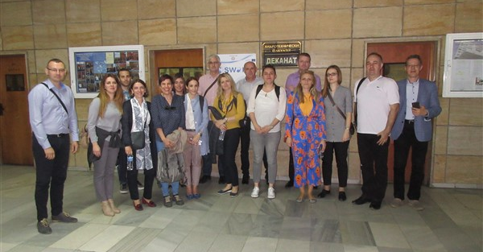
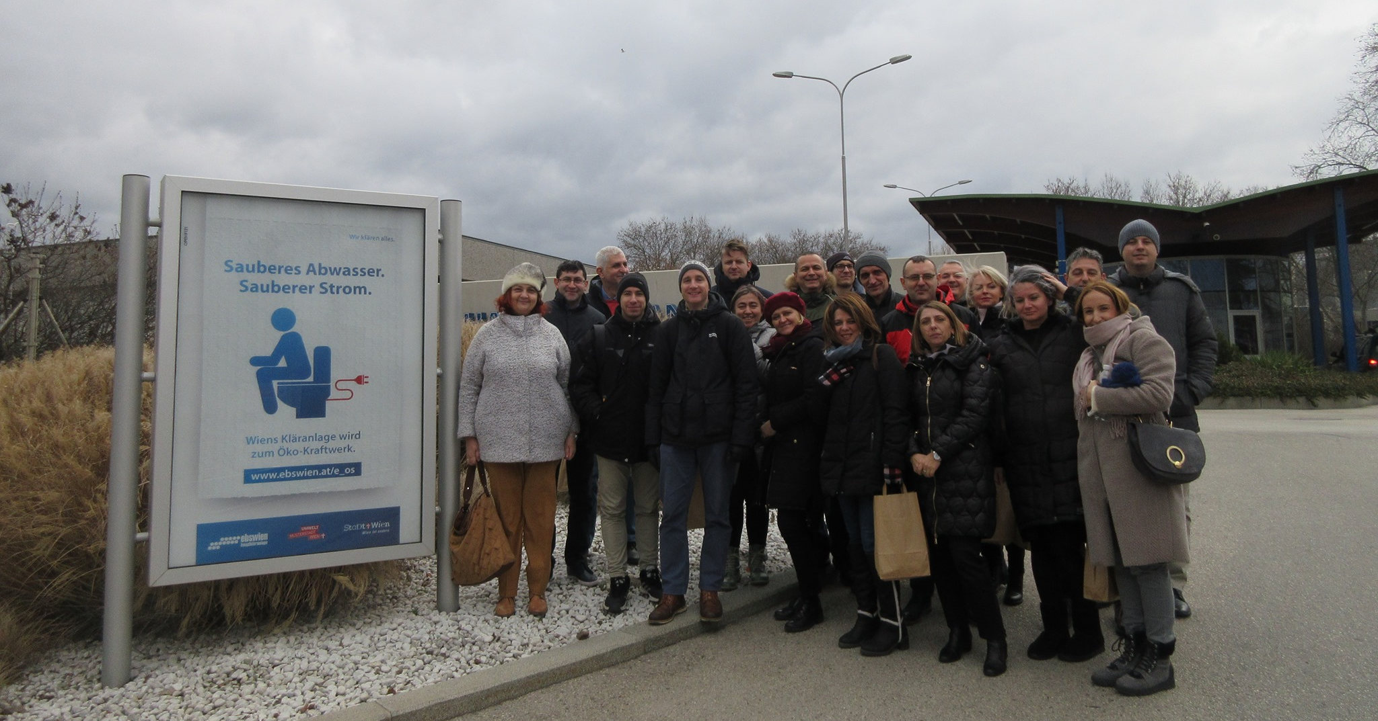
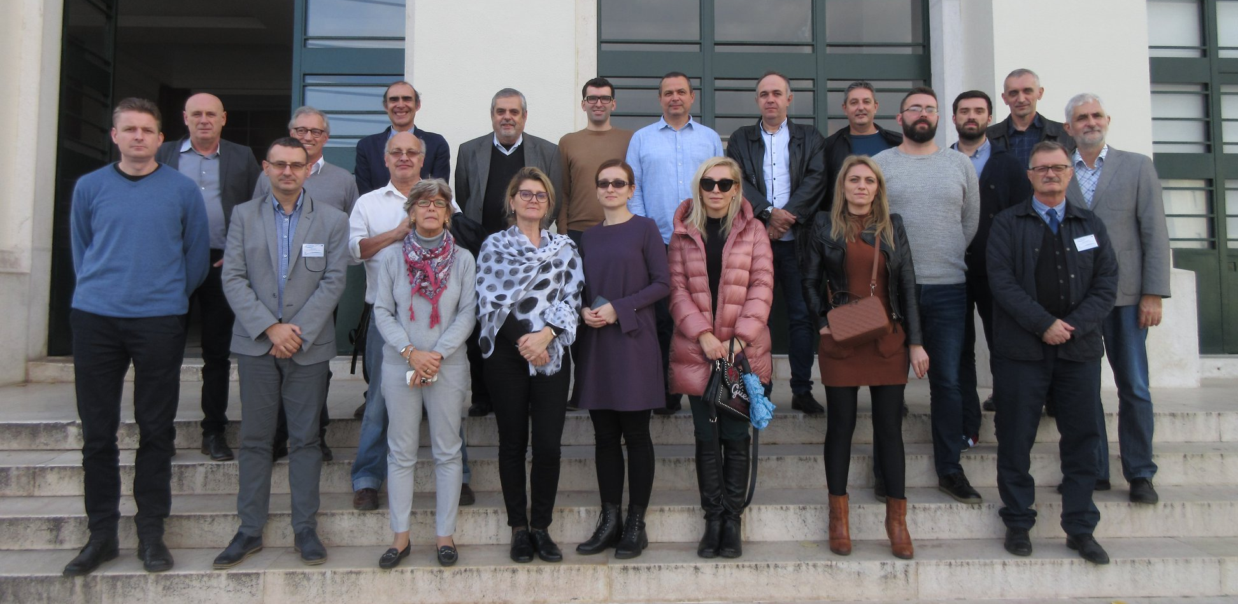
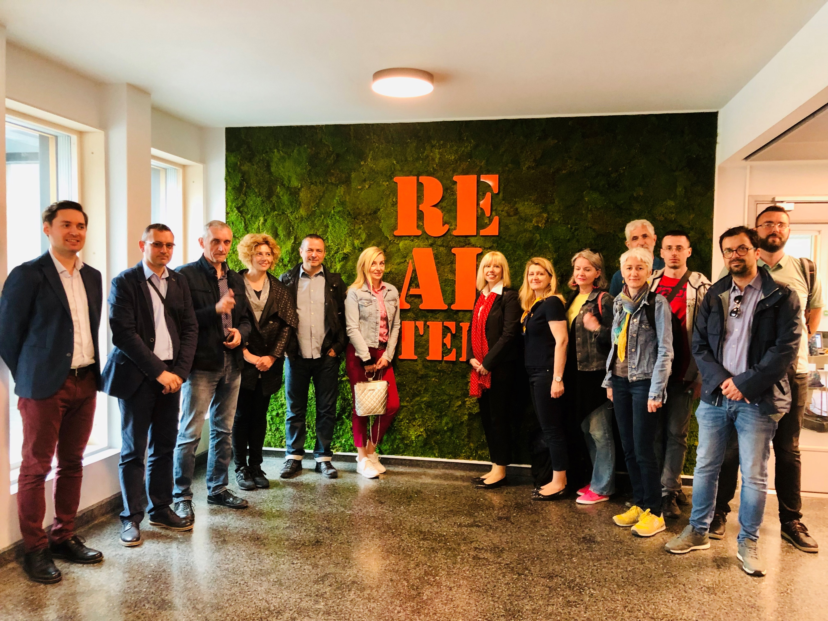
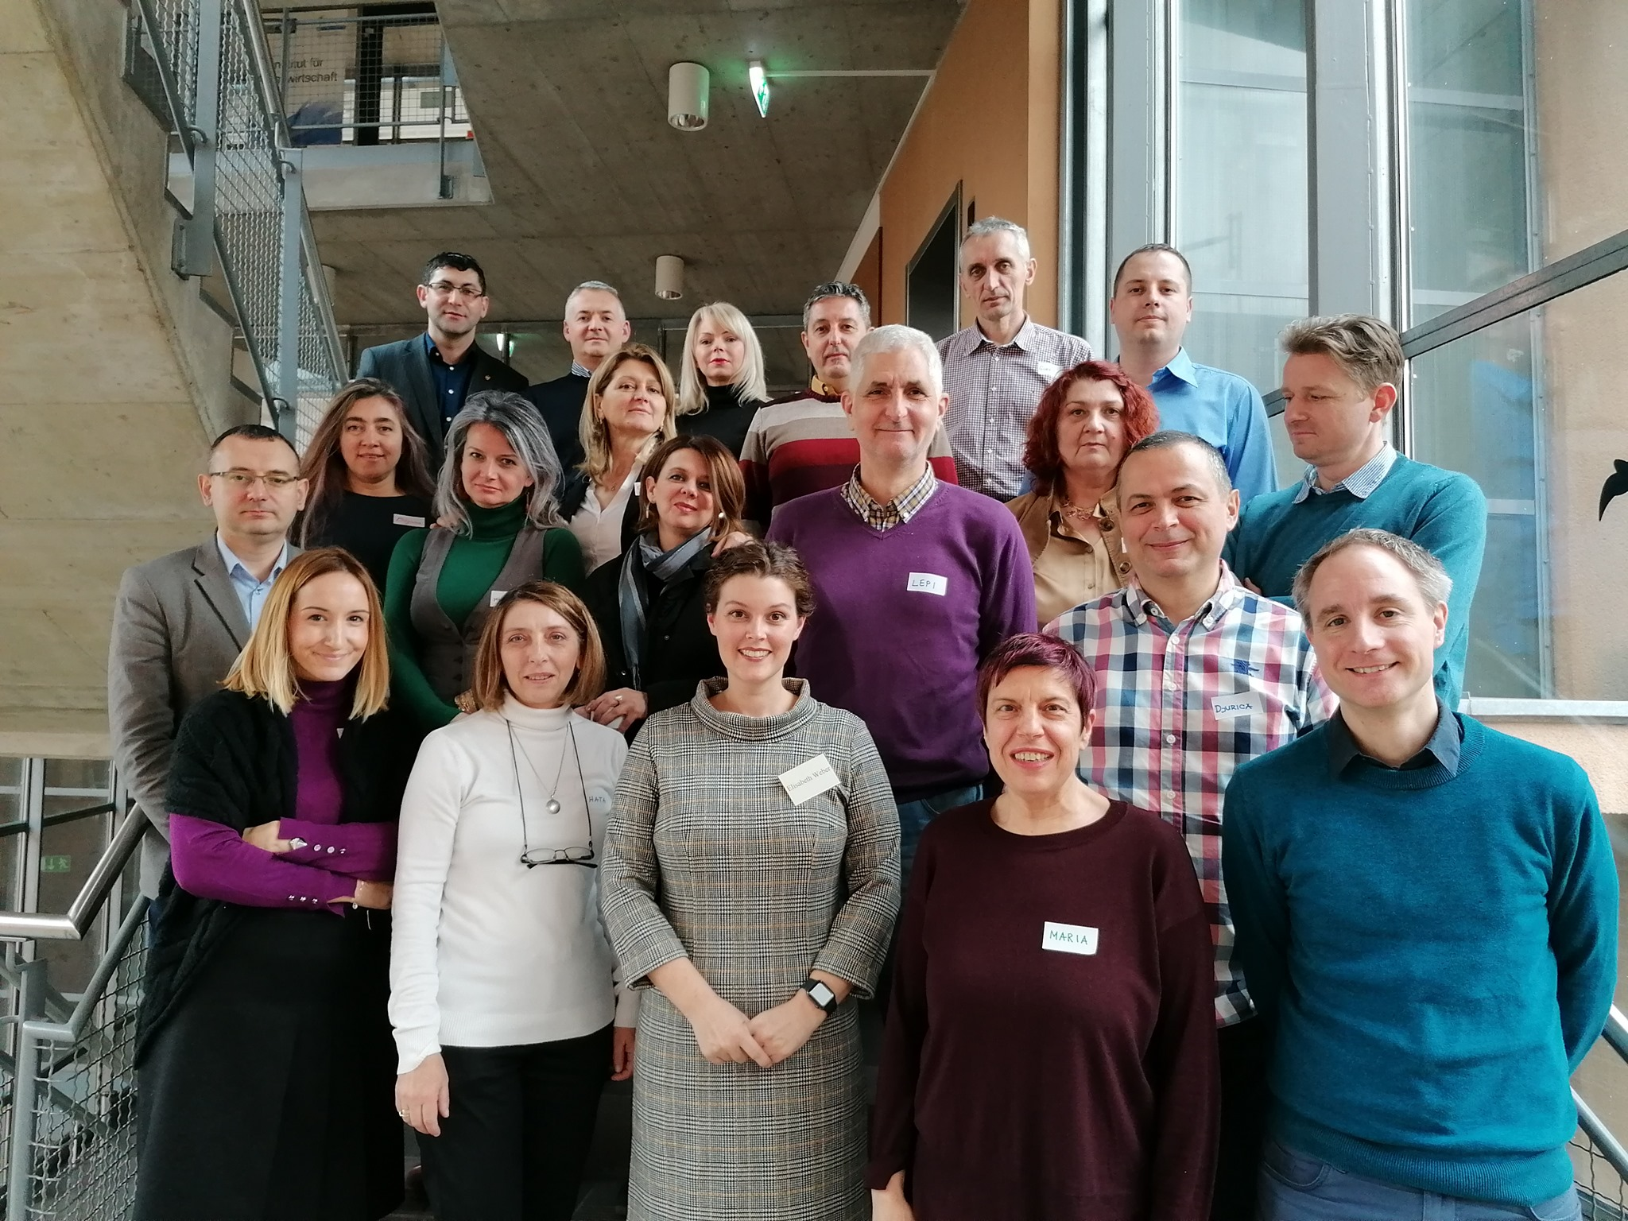
Theme-based training of teaching staff
Strengthening of master curricula in water resources management
for the Western Balkans HEIs and stakeholders
www.swarm.ni.ac.rs

Slide 15
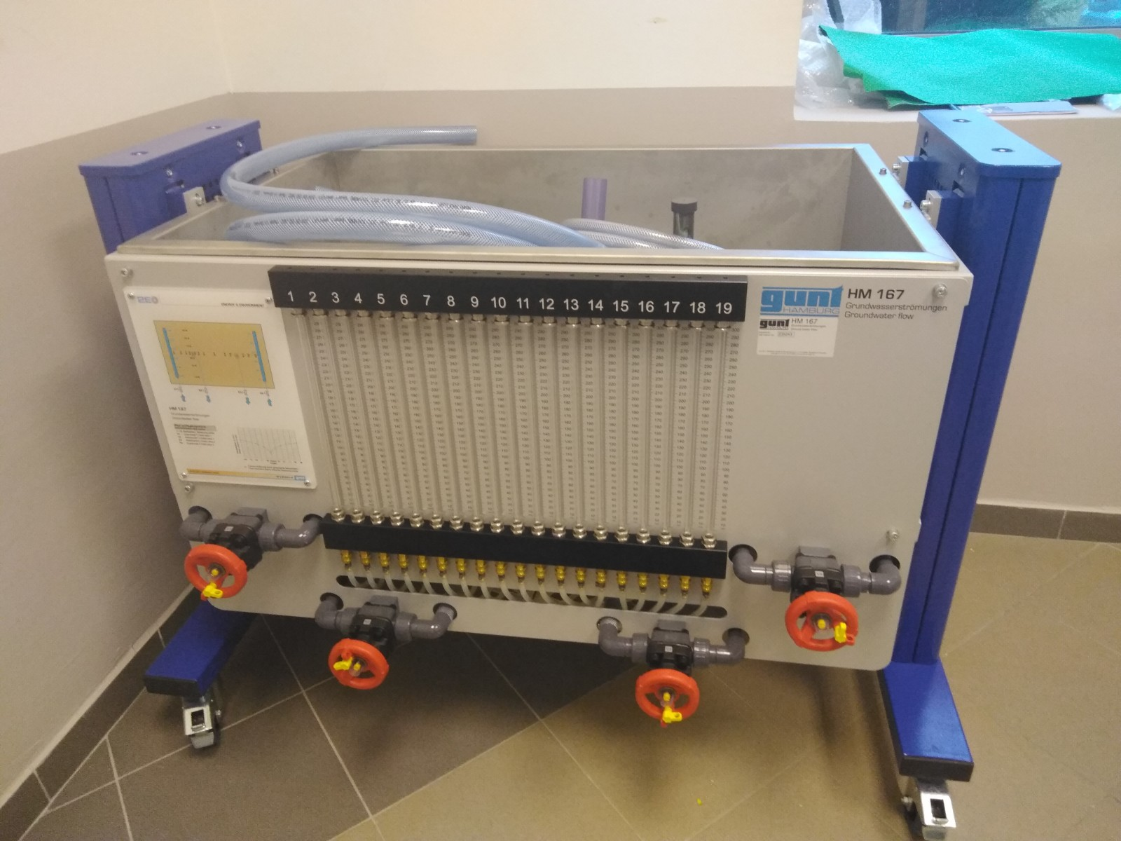
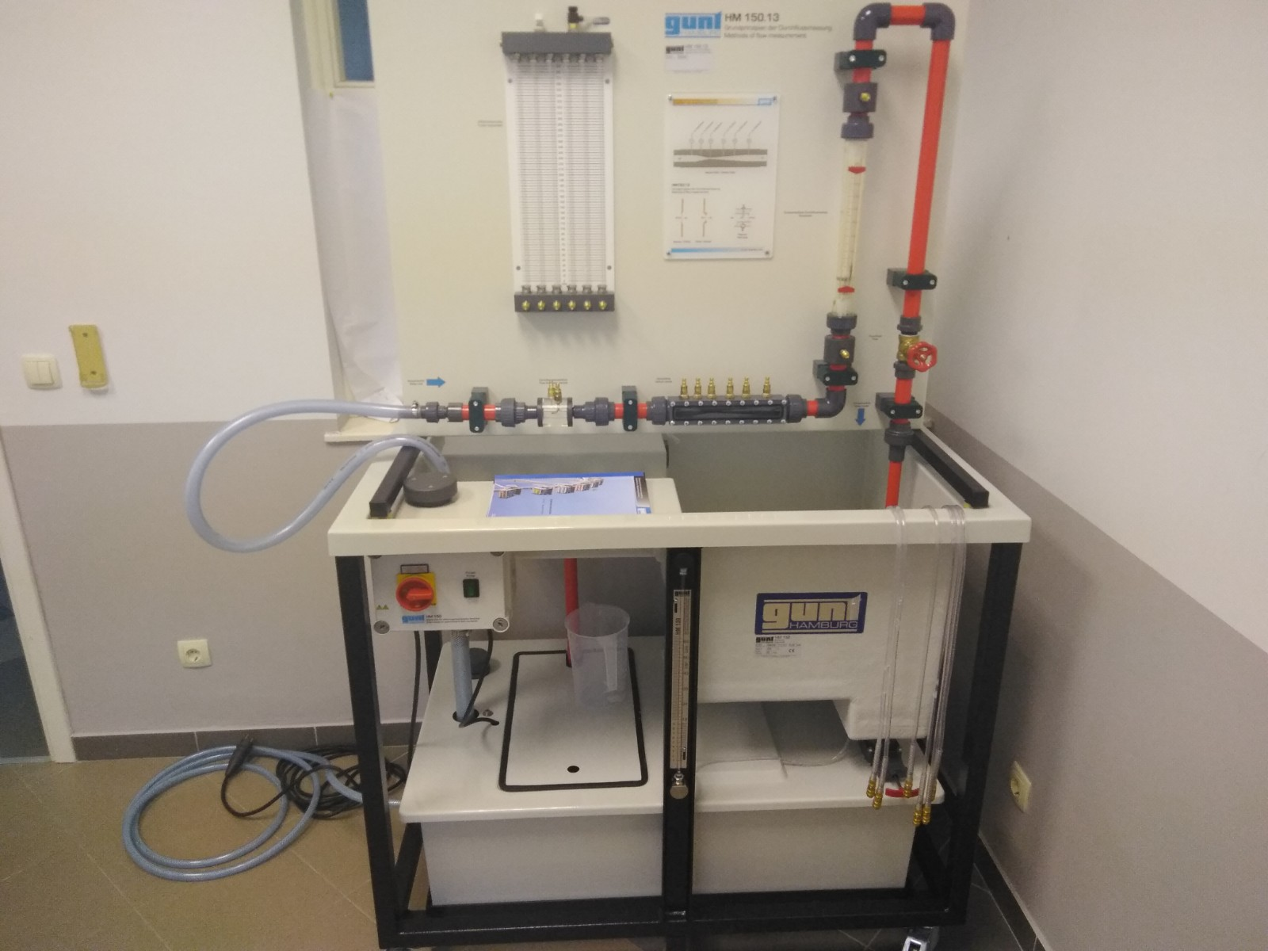
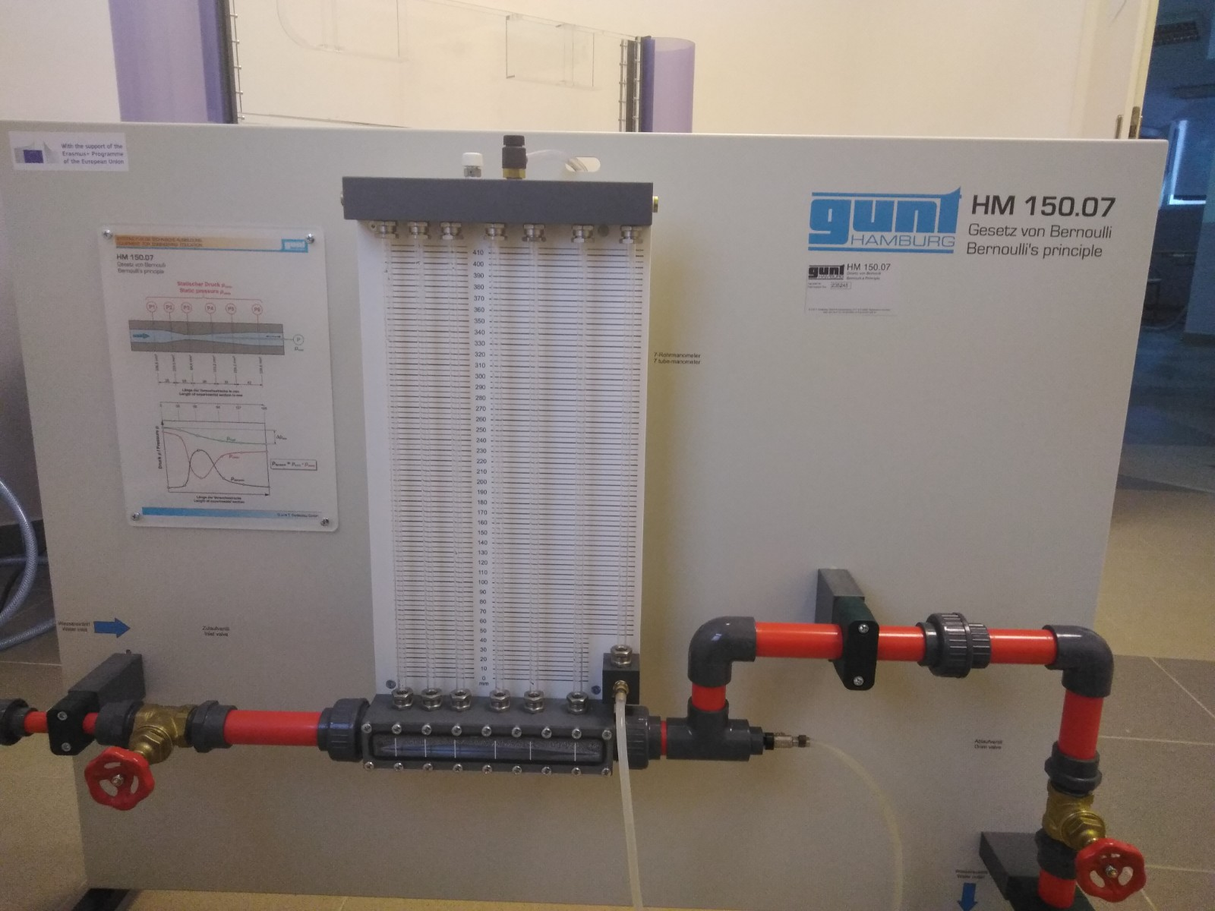
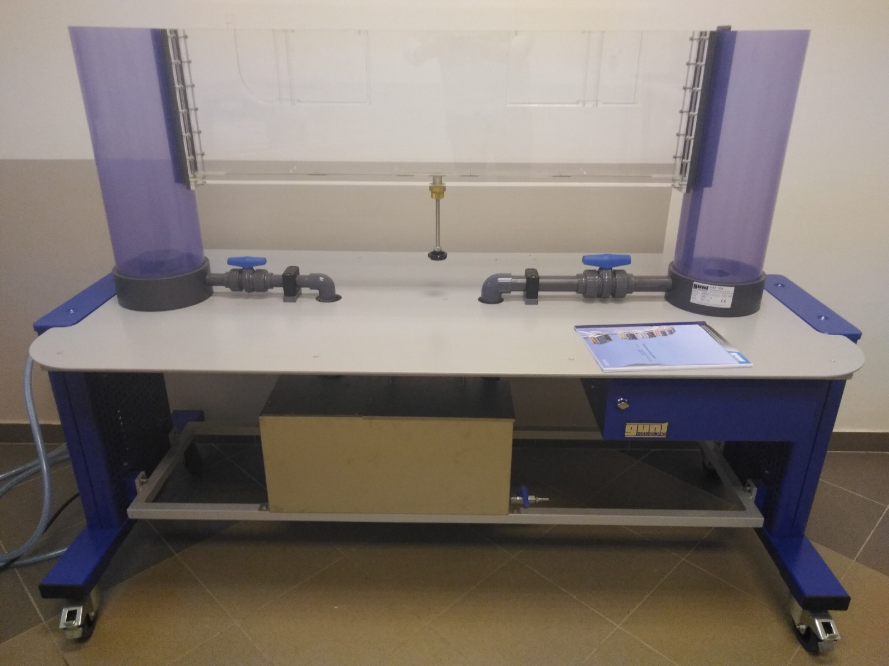
Purchased equipment
Strengthening of master curricula in water resources management
for the Western Balkans HEIs and stakeholders
www.swarm.ni.ac.rs

Slide 16
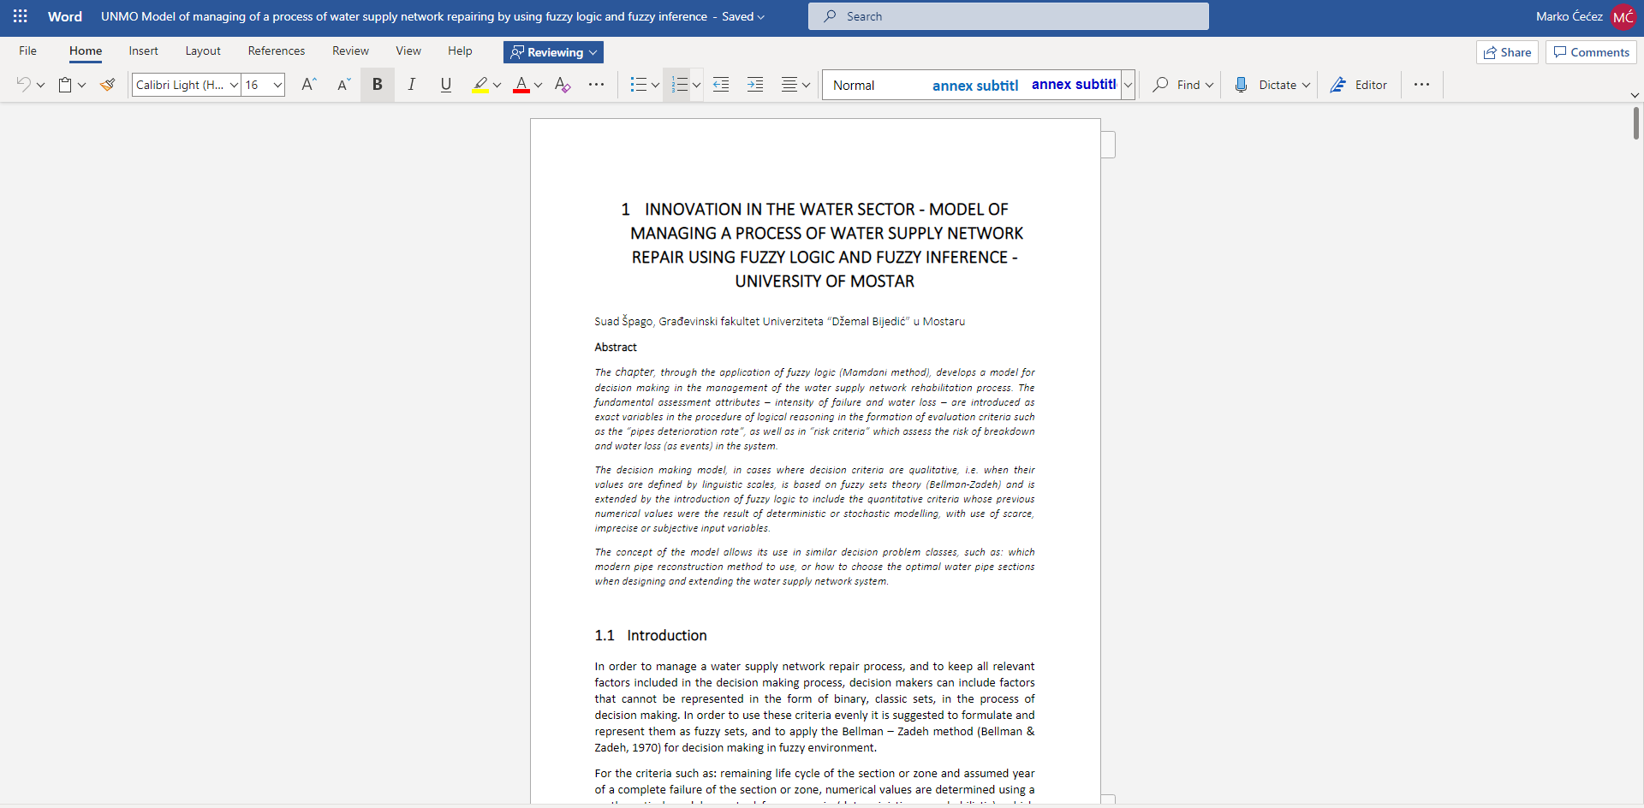
Training material
Strengthening of master curricula in water resources management
for the Western Balkans HEIs and stakeholders
www.swarm.ni.ac.rs

Slide 17
Promotion material
Strengthening of master curricula in water resources management
for the Western Balkans HEIs and stakeholders
www.swarm.ni.ac.rs

